Slide 1

Transforming the Movie Industry
AI Driven Approach to More Effectively Selling New Movie Scripts
DSO 560 Final Project
Chris Madison, Michael (Mike) Levitas, Nick Pettit, Saketh Mallagun

Slide 2

Executive Summary
Mechanical | 3

Slide 3
Project Overview
Determine a business problem that could be solved using NLP techniques taught in class
Our team took on the role of a movie talent agency that sells new movie scripts to studios
Build a predictive model to solve this problem and evaluate its performance
Our team created a machine learning model for predicting likelihood of purchase and evaluated its viability at an enterprise level
Project future implications and benefits of this new approach
Our team provided recommendations on benefits, next steps and implementation

Slide 4








Opportunities in the Current Marketplace
01
Volume of Screenplays
01
According to The Writers Guild of America, 50,000 new screenplays are registered annually.
02
Cost Per Purchase
03
02
The Writers Guild of America payment for an original
screenplay has minimum of $81,220 and high of $152,461
03
Streaming Platform Variety
There are close to 50 streaming services from well-known brands in North America alone.

Slide 5
Business Solution and Approach
Current Approach
Untargeted Marketing
Same pitch to studios regardless of movie content or type
Time Intensive in a low success rate environment
Only 10% sales conversion rate at an average selling price of $110,000
Why our Approach is Superior
Optimized Sales Strategy
Machine Learning approach to target companies with the highest purchasing probability
Increased Profits
Higher conversion rate without increasing sales staff headcount

Slide 6
Overall Findings
Our research indicates high potential for growth with new machine learning approach
Return on investment after 28 additional sales*
5% Sales conversion rate increase
20% Projected sales increase first year*
Key Costs and Risks
Key Benefits
Initial cost and time investment of a small, agile team of data scientists and project leader
Tailored approach to each script reduces time needed for pitch meetings
Increased ROI without increasing sales staff headcount
Risk that model may not perform well on new studios or script types
*Please see appendix for detailed projections

Slide 7

Detailed Methodology and Path to Implementation
Mechanical | 3

Slide 8
Dataset
Data Sourced From Reelgood.com
Provider of market data on movie industry
33 MB File and approximately 40,000 rows of data across 20 Streamers
19 Features with characteristics of each movie that are both numeric and categorical
Movie Distribution covering all rating categories to ensure data coverage
All movies contain a description and the studio that purchased

Slide 9
Data Cleaning
Key Steps
Standardize Provider Names
ex. HBO and HBO Max = HBO
Filter Unneeded Data
ex. Removed platform labeled “free/rent”
Apply Text Cleaning Principles
Lowercase and lemmatize text
Remove punctuation, special characters and stop words
Dropped duplicates to ensure one title per platform
“80 percent of a data scientist’s valuable time is spent simply finding, cleansing and organizing data” - IBM

Slide 10


Feature Engineering and Model Preprocessing
Two Additional Variables were Created via Sentiment Analysis
Content summary coded as pos. or neg.
Recoding:
Positive = 1
Negative = 0
Content summary given polarity score ranging from -1 to 1
-1 = Very Negative
1 = Very Positive
0 = Neutral/Unknown

Slide 11
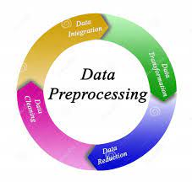
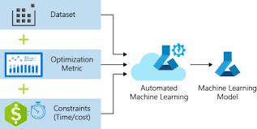
Model Selection
Data Preprocessing
Use different vectorization techniques (word2vec, tf-idf) for testing model inputs
Extraneous Variables (IMDB Rating, Release Year, etc.) had little additional predictive power
AutoML For Model Selection
Let program decide which model
architecture is best
Save model for reproducibility
Highly scalable in cloud environment with
production level options

Slide 12
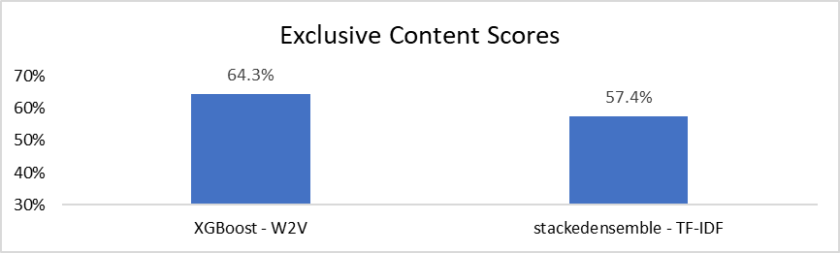
Exclusive Content Model Results
Two Models were trained specifically for selling Exclusive Content
Both models performed above the benchmarked rate of 42%
XGBoost would be model of choice with highest accuracy

Slide 13
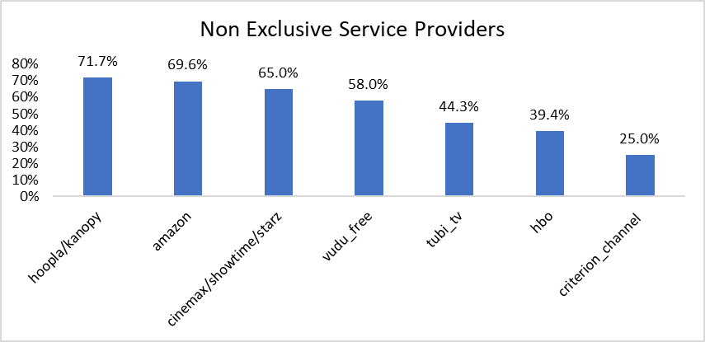
Non-Exclusive Model Performance
Performance was mixed, with seven studios that we could confidently target more effectively
Highest accuracy for targeting Hoopla/Kanopy or Amazon

Slide 14


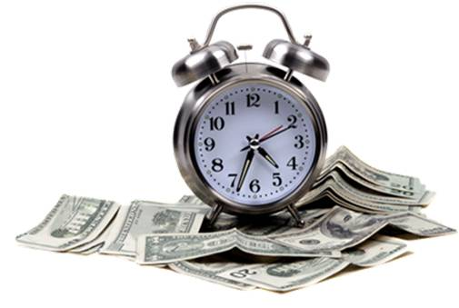
Assembling the Full Team
Need an experienced team of three data scientists and one senior project leader
NLP Engineer Average Salary of $150k
Project Manager Average Salary of $110k
Team Total Compensation costs of approximately $600k
Initial time investment of six months
2 months of data collection and cleaning
4 months of model testing and implementing

Slide 15
Roadmap for Production
Key Tasks | Sprint 1 | Sprint 2 | Sprint 3
Touchpoints | 1 | 2 | 3
Data Collection
Data Cleaning
Feature Engineering
Build and tune models
Understand performance & determine final model
Develop Front End Application
Test and Put into Production
Milestone touch points every 2 months to meet six month timeframe with additional touch points as needed

Slide 16
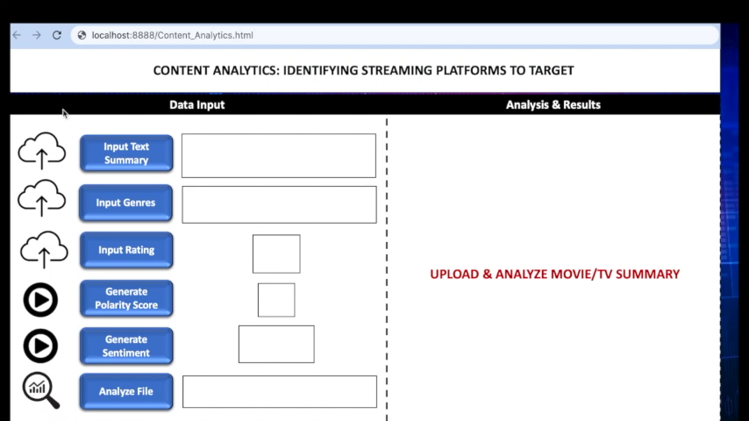
Production Level Implementation Example - Video

Slide 17

Appendix
Mechanical | 3

Slide 18

Further Improvements
Hugging Face Sentiment Analysis Model or testing out more complex architectures such as BERT learning
Fine-tune model on movie/TV specific summaries
Can expand to screenplays if success with movie scripts which is highly scalable using H2O AutoML platform
Test our own custom word embeddings

Slide 19
Detailed Financial Projection
About 50,000 movie scripts registered with WGA yearly (only about 10% sold)
Our company is in line with market at a 10% conversion rate, trying to sell about 1000 scripts per year and actually selling 100
Services will be rendered for a 20% commission (comparable to a writer’s agent/manager fee of 10%)
Selling 100 at the average price of $110,000 currently gives us about $2.2 Million in revenue per year
Based on our model being above the benchmark rate, we expect to increase the conversion rate by 5%
5% increase means selling 50 additional scripts per year
28 scripts will cover the cost of the initial investment with $484k profit after first year in production.

Slide 20
References
https://www.studiobinder.com/blog/screenwriter-salary-how-much-do-screenwriters-make/
https://freshmenscreenplay.com/how-many-screenplays-are-written-and-sold-each-year/
https://www.wga.org/contracts/contracts/schedule-of-minimums
https://www.forbes.com/sites/derekbaine/2021/12/22/how-many-streaming-services-can-people-consume-ott-services--vmvpds-continue-to-soar/?sh=75a6a5d631bb

